Slide 1
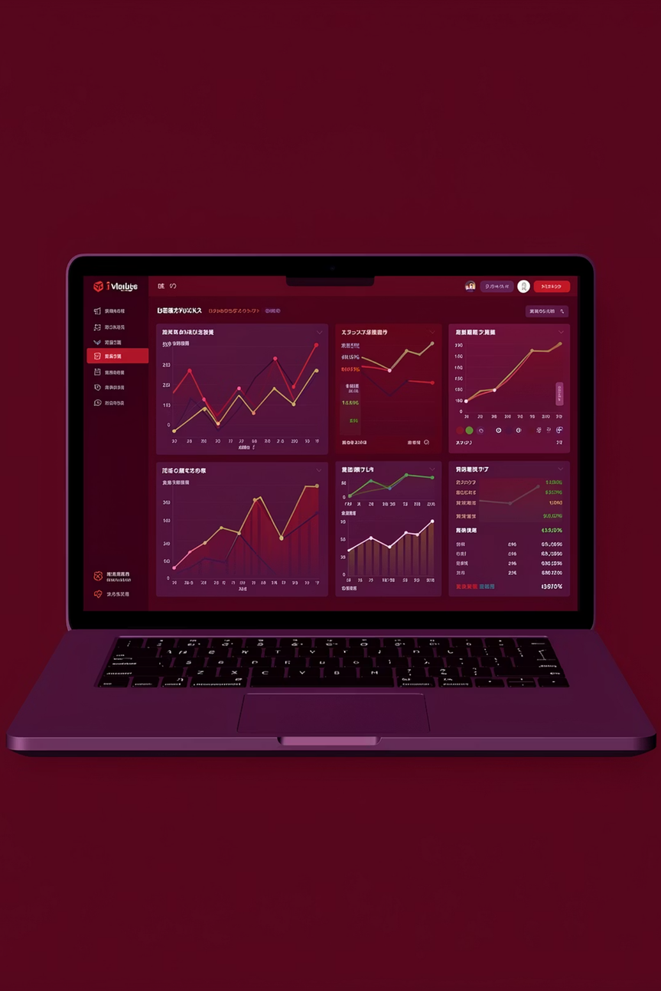
Finance Tracker: A Full-Stack Web Application
A secure, intuitive platform for managing personal finances with real-time insights and visual analytics
Name: ChagamReddy Anush Reddy
UID:24BAI70811
Name: Chaitanya Jedage
UID:24BAI70865
Subject:Fullstack

Slide 2
Project Overview
What is Finance Tracker?
Why Build This Application?
A comprehensive web application that empowers users to monitor their financial health through automated tracking, intelligent categorization, and interactive data visualization. Users can securely log transactions, analyze spending patterns, and make informed financial decisions.
Traditional expense tracking methods are time-consuming and lack visual insights. This application bridges the gap between raw financial data and actionable intelligence, providing users with clear, real-time understanding of their money flow.

Slide 3
The Challenge
Manual Tracking Burden
Limited Visual Insights
Data Security Concerns
Spreadsheets and notebooks require constant manual updates, leading to data entry fatigue and inconsistent record-keeping
Traditional methods fail to provide intuitive visual representations of spending patterns and financial trends
Spreadsheets lack proper authentication and encryption, exposing sensitive financial information to unauthorized access

Slide 4
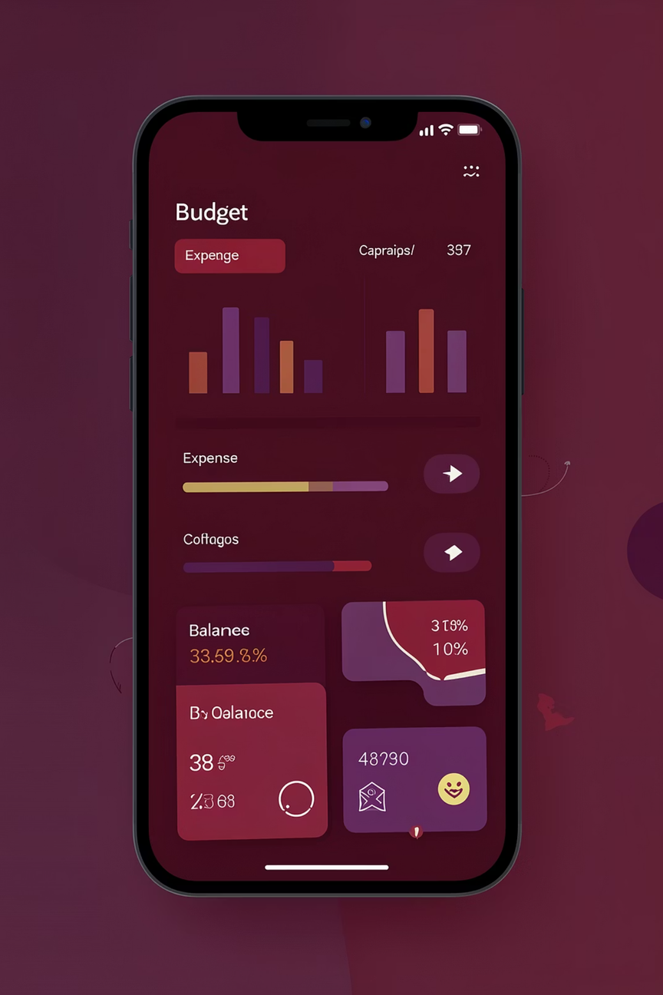
Our Solution
01
Centralized Platform
Single, secure location for all financial transactions with cloud-based data persistence
02
Smart Categorization
Intuitive classification of income and expenses with customizable categories
03
Visual Analytics
Interactive charts and graphs that transform numbers into meaningful financial stories
04
Real-Time Dashboard
Instant overview of financial health with dynamic balance calculations

Slide 5
Core Features
Secure Authentication
Transaction Management
JWT-based login system with encrypted password storage ensures only authorized users access sensitive financial data
Add, edit, and categorize income and expenses with ease using an intuitive, responsive form interface
Dynamic Balance
Interactive Charts
Automatic calculation of running balance as transactions are added, providing instant financial status updates
Visualize spending patterns with Recharts-powered graphs that update in real-time with new transaction data

Slide 6
Technology Stack
Frontend
Backend
React.js
Node.js
CSS3
Express.js
Recharts
Database
Security
PostgreSQL
JWT Tokens
Neon Hosting
bcryptjs
Sequelize ORM

Slide 7
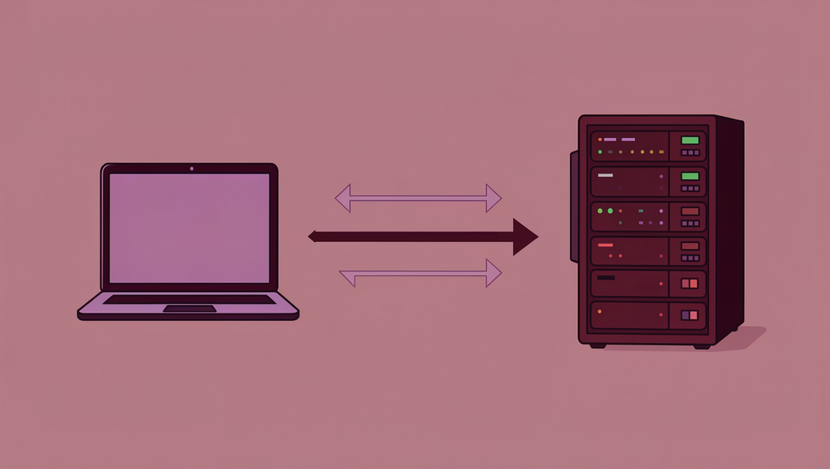
System Architecture
Client-Server Model
The application follows a three-tier architecture where the React frontend serves as the client, Node.js/Express handles server-side logic, and PostgreSQL manages persistent data storage.
API Communication: RESTful endpoints enable seamless data exchange between client and server using HTTP requests
Data Flow: User actions trigger API calls that process data and update the database, with responses rendered on the frontend

Slide 8
Database Schema & Security
1
2
Users Table
Transactions Table
Stores user credentials with encrypted passwords, email addresses, and authentication tokens. Primary key ensures unique identification.
Tracks income and expenses with foreign key relationship to Users table, maintaining data integrity through referential constraints.
3
4
JWT Authentication
Password Encryption
Stateless token-based authentication provides session management without server-side state, enhancing scalability and security.
bcryptjs implements salted hashing to protect user passwords, ensuring even database administrators cannot access plain-text credentials.

Slide 9
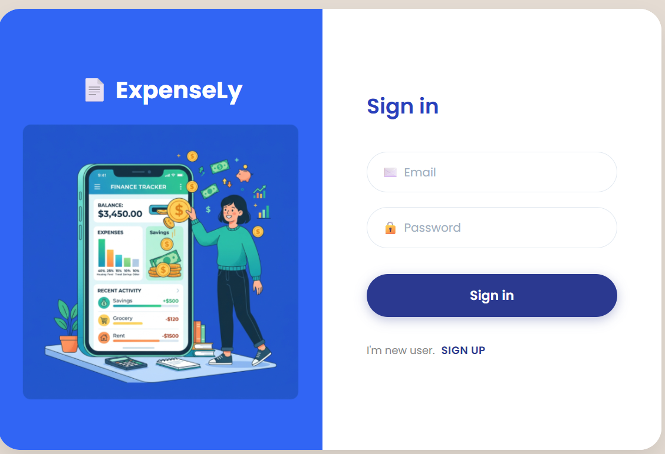
Application Flow
Login Page
Users authenticate with secure credentials

Slide 10
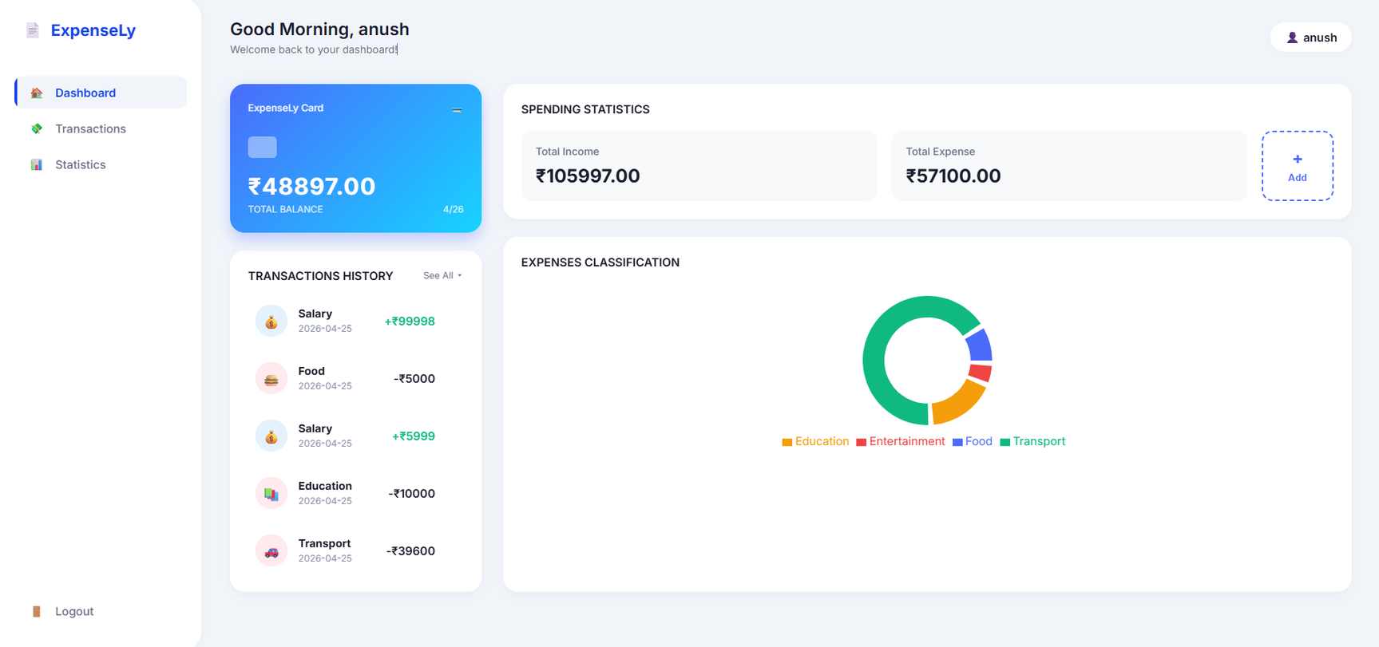
Dashboard View
Overview with charts and balance summary

Slide 11
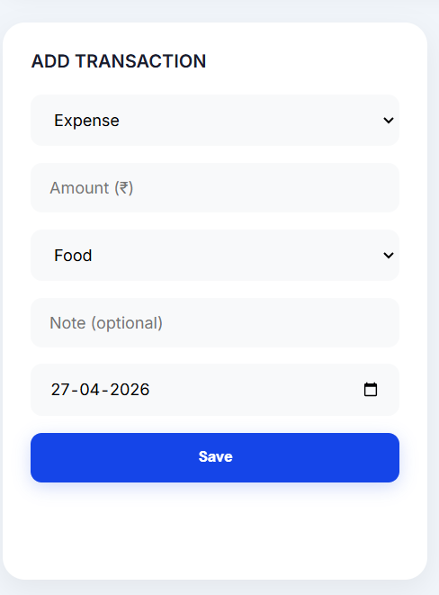
Add Transaction
Form interface for new entries

Slide 12
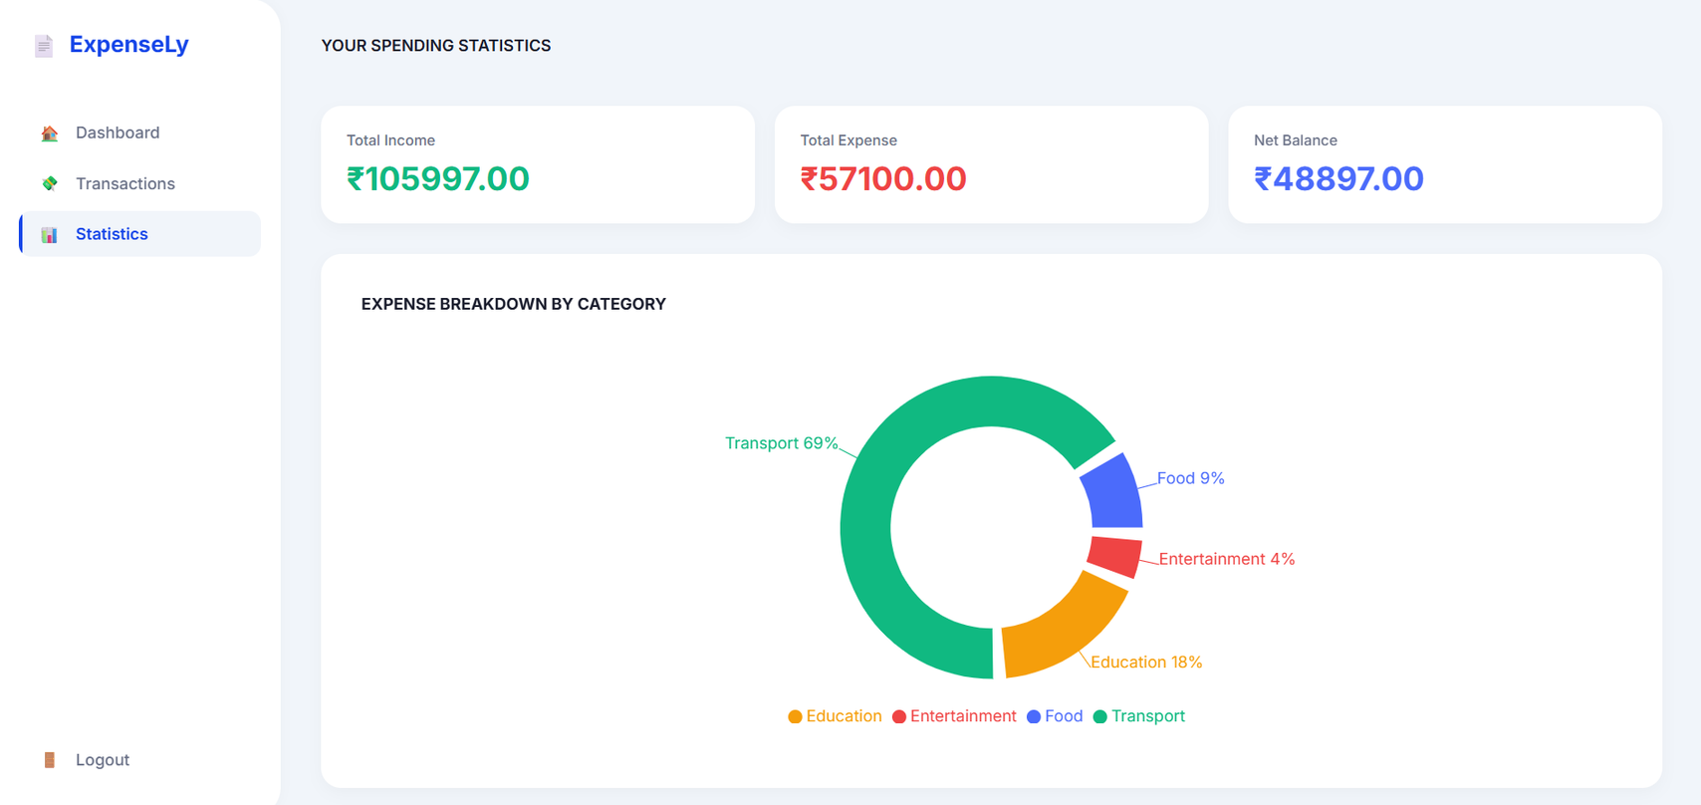
Visual Analytics
Interactive charts display spending patterns

Slide 13
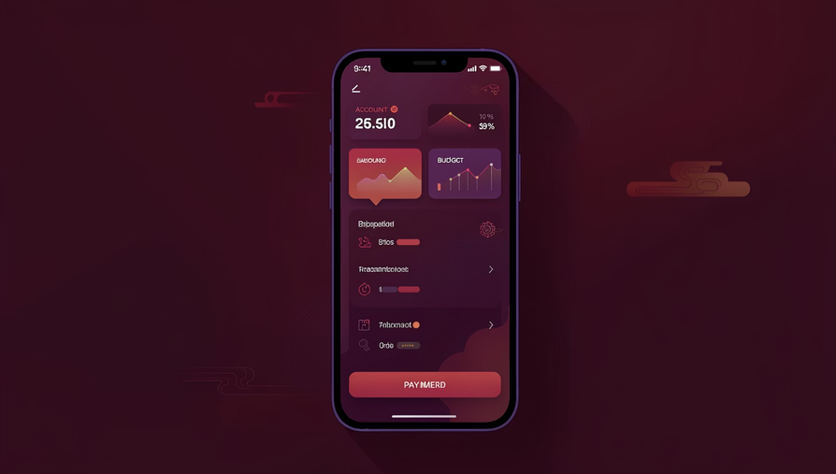
Future Enhancements & Conclusion
Planned Features
CSV Export: Download transaction data for external analysis and record-keeping
Budget Goals: Set monthly spending limits with notifications when approaching thresholds
Mobile App: React Native companion application for on-the-go expense tracking
Expense Forecasting: AI-powered predictions based on historical spending patterns

